Slide 1
Controlled Assessment
Samuel Simpson
Centre Number: 51339
Candidate Number: 6041

Slide 2
Design Task 8 – Sound and Music
Chosen Brief

Slide 3
Design Brief
Context
Modern technologies based on music and communication play an important part in people’s lives today and can be used as strong personal statements.
Design Task 8 - Sound and Music
Design and make a product using sound or music. It could be a toy which plays a lullaby for the baby, an MP3 player dock, doorbell chime, an amplifier for ring tones, even a metronome - the product should reflect its application.

Slide 4
My Idea
A spectrum analyser that has:
A Black case
A RGB display
A IR Remote control
Microphone input
Aux input

Slide 5
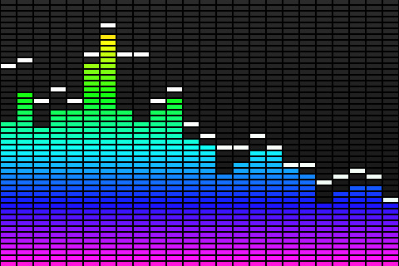
What is an audio spectrum analyser?
Spectrum analysis can be used at audio frequencies to analyse the harmonics of an audio signal.
Spectrum analyzers are also used by audio engineers to assess their work.
In these applications, the spectrum analyzer will show volume levels of frequency bands across the typical range of human hearing, rather than displaying a wave.
In live sound applications, engineers can use them to pinpoint feedback.
In short: Spectrum analyzer show the level of the audio at different frequencies and in this case they are more to do with the fact that they look good as a disco-light.
In this instance I plan to make one to be a disco-light as otherwise I would have to get it calibrated and I do not plan to get it calibrated as the input resolution required would need an accurate audio input and it is just better to use a computer's sound-card and some free software such as Spek.

Slide 6
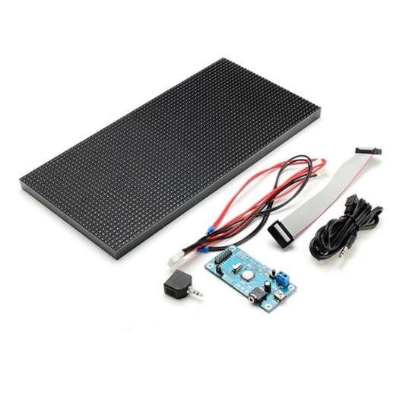
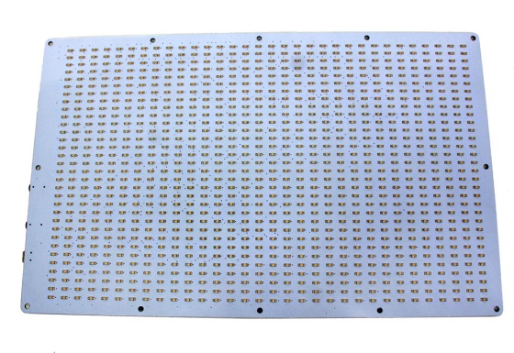
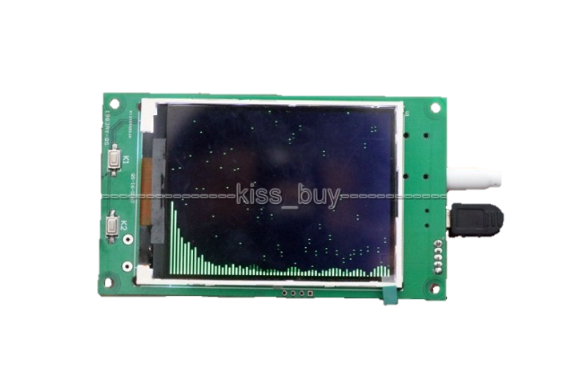
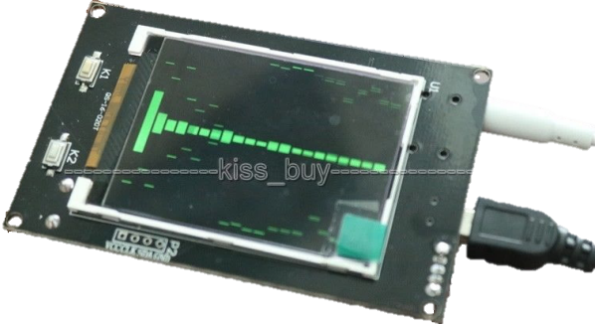
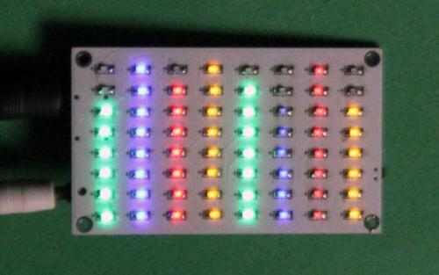
Similar Products

Slide 7
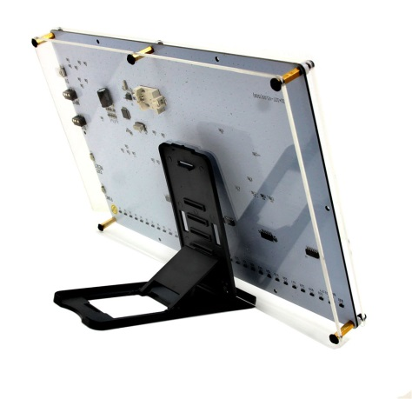
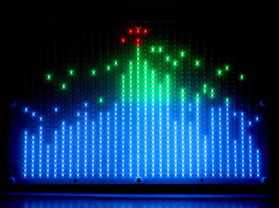
RGB 32*32 Screen Audio LED Level Meter Display Spectrum Analyser DIY Amplifier
Feature | Description | Comment
Cost | £61.75 + £9 P+P | Expensive for what it is as it has a cheap plastic case which looks like it would break easily
Aesthetics | Clear Plastic, White PCB, Visible Components ½ Kg Coloured Leds Large (25x15cm) | Not very pretty as components are visible Light Leds are fixed colours The casing material makes the product look cheap
Customers | Audiophiles, Techies | Limited Market Due to Aesthetics as all the electronics are visible and the product looks cheap because of the casing material
Materials | Plastic/PCB/Acrylic | It is made of cheap materials as it is not a very high quality product
Environment | Nothing Recyclable | Not Environmentally Friendly as the product is made using plastic which is recyclable in some case but as it is a mixture of plastics and it contains electronics it is not recyclable
Safety | 5v @ 150mA Lightweight | Low power/current so no risk of electrocution Lightweight so it won’t hurt someone if it fell on them It has rounded corners
Function | Lights up the individual columns depending on the level of the audio in that specific frequency range | It can be used for Party's/Discos as the light flash in time with the beat
Parameters:
Power from: USB 5V,150mA
Box size:275mm*170mm
LED size:250mm(W)*150mm(H)
32*32 matrix LED display.
Net weight: 0.5Kg (0.8Kg with package)
Features:
the LED will dance with the music.
with memory function （need install the battery）
5 style display mode
Can display the year / month / date / hour / min / week
Can adjust the LED speed / L&R channel display mode / Gain / Sensitivity / brightness
The display frequency range is: 300/600/900/1.2K/1.5K/1.8K/2.1K/2.4K/2.7K/3K/3.3K/3.6K/3.9K/4.2K/4.5K/4.8K/5.1K/5.4K.......total 32 rows.
Package included:
1x LED display panel
1x stand
1x USB cable
1x 3.5mm cable
Notes:
http://www.ebay.co.uk/itm/RGB-32-32-Screen-Audio-LED-Level-Meter-Display-Spectrum-Analyzer-DIY-Amplifier/272345114144?_trksid=p2047675.c100623.m-1&_trkparms=aid%3D222007%26algo%3DSIC.MBE%26ao%3D2%26asc%3D20160323102634%26meid%3Dfd2be02ae40040b0979dd9e0fd9fadf4%26pid%3D100623%26rk%3D3%26rkt%3D6%26sd%3D281960428185

Slide 8
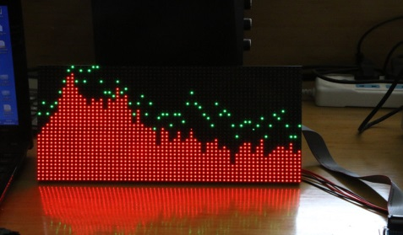
MS3264 V3 digital Level Meter Music Spectrum Display 6 Modes DIY LED Audio amp
Feature | Description | Comment
Cost | £45.99 | Expensive for what it is as it does not come with a case enclosing the electronics
Aesthetics | Clear Plastic, PCB, Visible Components ½ Kg Coloured Leds Large | Not very pretty as components are visible Light Leds are fixed colours Components are not one unit
Customers | Audiophiles, Techies | Limited Market Due to Aesthetics as it does not have a proper case
Materials | Plastic/PCB | It is made using the bare minimum of materials to make the product work but as it does not have a case enclosing the electronics
Environment | The metals used to make the cables, components and PCB can be recovered but the plastic is most likely not recyclable | Partially Environmentally Friendly as the component it is a mixture of plastic and electronics which cannot be separated but the metals could be extracted
Safety | 5v Lightweight | Low power/current so no risk of electrocution Lightweight so it won’t hurt someone if it fell on them It has sharp corners
Function | Lights up the columns to show the level of the audio in the frequency range | It can be used for Party's/Discos as it flashes in time with the beat but it can also be used for sound engineers to see what frequencies can currently be heard
Features:
Using the latest SMD dual colour dot-matrix display modules, more vivid colours and lower power consumption.
Dot-matrix screen software using the original software filtering technology, spectrum effects has increased significantly.
Main features:
Spectrum display more gentle, no spikes appear. Sensitivity and sense of rhythm is better, visual effects more beautiful.
Improved the other spectrum frequency is too rich, insufficient high frequency phenomena, the effect is more dynamic. With power off memory function.
The streamlined design of the spectrum, not static and noise.
Package Contents
1x Controller
1x Colour dot matrix
1x USB power supply audio cable
1x audio splitter
1x 16-core data cable
Notes:
http://www.ebay.co.uk/itm/MS3264-V3-digital-Level-Meter-Music-Spectrum-Display-6-Modes-DIY-LED-Audio-amp/172372377389?_trksid=p2047675.c100005.m1851&_trkparms=aid%3D222007%26algo%3DSIC.MBE%26ao%3D2%26asc%3D20140122125356%26meid%3D15e06398b5b84af19b9642b78c10ba2d%26pid%3D100005%26rk%3D6%26rkt%3D6%26mehot%3Dpp%26sd%3D332013396318

Slide 9
8*8 Audio Level Meter LED Display Amplifier HIFI MP3 PC Music Spectrum Analyser
Feature | Description | Comment
Cost | £8.01 | Cheap as it is just a bare PCB with no proper case to protect the
Aesthetics | Clear Plastic, White PCB, Visible Components Small Coloured Leds | Not very pretty as components are visible Light Leds are fixed colours Looks Cheap The re is no case to protect the PCB
Customers | Audiophiles, Techies | Limited Market Due to Aesthetics as it is just a plain PCB with some component s
Materials | Plastic/PCB | Cheap as it does not include a case to protect the PCB
Environment | PCB and components recyclable as the metal can be extracted | The metals used to manufacture the product can be extracted from the components and PCB so it can be recycled
Safety | 5v Lightweight | Low power/current so no risk of electrocution Lightweight so it won’t hurt someone if it fell on them It has sharp corners
Function | Lights up the bars to show the level of the frequency in that range | It can be used as a toy but is not very practical for anything as the resolution is so low
Notes:
http://www.ebay.co.uk/itm/8-8-Audio-Level-Meter-LED-Display-Amplifier-HIFI-MP3-PC-Music-Spectrum-Analyzer/141924416367?_trksid=p2047675.c100005.m1851&_trkparms=aid%3D222007%26algo%3DSIC.MBE%26ao%3D2%26asc%3D20140122125356%26meid%3D4ec9f84d1368432e95e971e059e6334c%26pid%3D100005%26rk%3D3%26rkt%3D6%26sd%3D131761883124

Slide 10
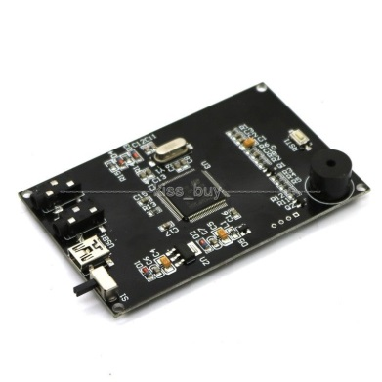
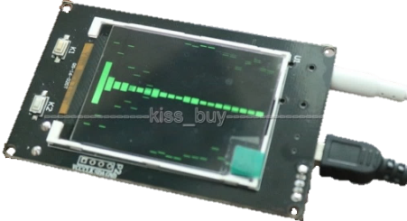
2.4" LCD Music Spectrum Display Analyser MP3 PC Amplifier Audio Level Indicator
Features:
Spectrum display interface.
Default parameters:
Mode 0,
display mode :(10 modes)
Columnar spectral width: 2
Gain: 0.5
Adjustable Gain (0.125,0.25,0.5,1,2,4.)
Foreground colour: GREEN
Adjustable colour "WHITE", "BLACK", "BLUE", "BRED", "GRED", "GBLUE", "RED", "MAGENTA", "GREEN", "CYAN", "YELLOW", "BROWN", " BRRED "," GRAY.
Background Colour: BLACK
Adjustable colour "WHITE", "BLACK", "BLUE", "BRED", "GRED", "GBLUE", "RED", "MAGENTA", "GREEN", "CYAN", "YELLOW", "BROWN", " BRRED "," GRAY.
Package Contents
1x 2.4" TFT LCD level display music spectrum electronic rhythm Analyser
2X CABLE
Feature | Description | Comment
Cost | £14.99 | Cheap as it does not have a case to protect the PCB against damage
Aesthetics | Clear Plastic, PCB, Visible Components ½ Kg LCD Screen Small | Not very pretty as components are visible Light Screen Is small The is not case so the PCB is not protected
Customers | Audiophiles, Techies | Limited Market Due to Aesthetics as it does not include a case
Materials | Plastic/PCB | Cheap as there is to case to prevent the PCB from getting damaged
Environment | PCB and components recyclable as the metal can be recovered | The metals used to manufacture the product can be extracted from the components and PCB so it can be recycled
Safety | 5v Lightweight | Low power/current so no risk of electrocution Light so cannot crush people It has sharp corners
Function | Lights up the individual columns with the level of the frequency of the sound in that specific frequency range | It can be used as a toy or it can be used by sound engineers to check audio levels but cannot be used at Parties/Discos as it is too small
Notes:
http://www.ebay.co.uk/itm/2-4-LCD-Music-Spectrum-Display-Analyzer-MP3-PC-Amplifier-Audio-Level-Indicator/182200160634?_trksid=p2047675.c100623.m-1&_trkparms=aid%3D222007%26algo%3DSIC.MBE%26ao%3D2%26asc%3D20160323102634%26meid%3D65a28fe2872f4a709c321fd918e01bc4%26pid%3D100623%26rk%3D4%26rkt%3D6%26mehot%3Dpp%26sd%3D172372377389

Slide 11
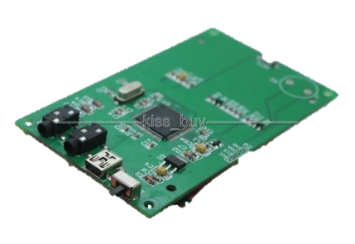
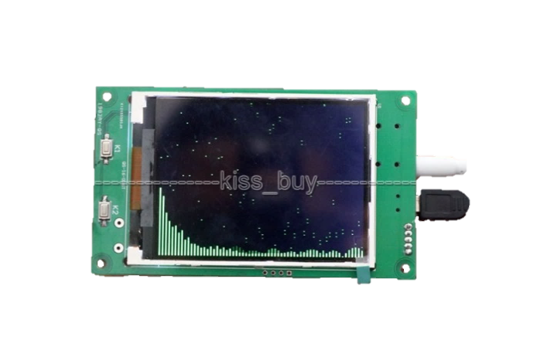
3.2" LCD Music Spectrum Display Analyser MP3 PC Amplifier Audio Level Indicator
Feature | Description | Comment
Cost | £18.89 | Cheap as it does not have a case to prevent the PCB from getting damaged
Aesthetics | Clear Plastic, PCB, Visible Components ½ Kg LCD Screen Small Lots of frequency bars | Not very pretty as components are visible Light Screen Is small Looks better with more bars It does not have a case
Customers | Audiophiles, Techies | Limited Market Due to Aesthetics as the is not case surrounding the PCB
Materials | Plastic/PCB | Cheap as it does not have a case to protect the PCB
Environment | PCB and components recyclable | The metals used to manufacture the product can be extracted from the components and PCB so it can be recycled
Safety | 5v Lightweight | Low power/current so no risk of electrocution Light so it won’t hurt anyone if it fell on them It has sharp corners
Function | Lights up the individual columns with the level of the frequency of the sound in that specific frequency range | It can be used as a toy or it can be used by sound engineers to check audio levels but cannot be used at Parties/Discos as it is too small
Features:
Spectrum display interface.
Default parameters: Mode 0,
display mode :(10 modes)
Columnar spectral width: 2
Gain: 0.5
Adjustable Gain (0.125,0.25,0.5,1,2,4.)
Foreground colour: GREEN Adjustable colour "WHITE", "BLACK", "BLUE", "BRED", "GRED", "GBLUE", "RED", "MAGENTA", "GREEN", "CYAN", "YELLOW", "BROWN", " BRRED "," GRAY.
Background Colour: BLACK Adjustable colour "WHITE", "BLACK", "BLUE", "BRED", "GRED", "GBLUE", "RED", "MAGENTA", "GREEN", "CYAN", "YELLOW", "BROWN", " BRRED "," GRAY.
Package Contents
1x 3.2" TFT LCD level display music spectrum electronic rhythm Analyser
2X CABLE
Notes:
http://www.ebay.co.uk/itm/3-2-LCD-Music-Spectrum-Display-Analyzer-MP3-PC-Amplifier-Audio-Level-Indicator/172396861937?_trksid=p2047675.c100005.m1851&_trkparms=aid%3D222007%26algo%3DSIC.MBE%26ao%3D2%26asc%3D20140122125356%26meid%3D52ecd45703da4024a1f65de4e12d9c92%26pid%3D100005%26rk%3D2%26rkt%3D6%26sd%3D182200160634

Slide 12
What I learnt
Using lots of frequency bands looks good
Using pure (Red, Green, Blue) colours is bad
They need a attractive case to be appealing to people who are not techies who like circuit boards with components on
Colour customisation – Led's can change colour
Using individual Led's looks good
Easy to use controls are a must
The option to use a microphone or a audio input port is a good idea
Using proper packaging is a good idea
A user manual would be a good idea
Different display modes would look good
Using a low voltage with a low current so there is a low risk of electrocution
Black is a good case colour as it is high contrast and doesn’t reflect the colour of the surrounding Led's
Producing a single unit is a good idea

Slide 13
Mind Map
Cases
Materials
Physical Shape
Metal
Wood
Plastic
ABS
Acrylic
Expensive
Cheap
Paintable
Hard to Shape
Rectangular
Easy to make
Simple
Plastics Stand at Back
Stable
Less chance of falling over
Underline – Chosen Idea

Slide 14
Target Audience
Audiophiles
Techies
Clubs/Discos
Teens
Classy
Professional
Look Cool
Many different features
Flashy
Bright
Impressive
Cool
Rugged
Impressive
Portable
Easy to Power
Underline – Chosen Idea

Slide 15
Peripherals
Inputs
Buttons
Mode
Brightness
Colour Adjust
Switches
On/Off
Input
Audio
Microphone
No Cables apart from power
Picks up background noise
3.5mm headphone jack
Low Distortion
Little background interference
Infrared Remote
Wireless
Easy
No need to touch the unit
Outputs
RGB Leds
Rectangular Grid
Addressable
Chainable
Buzzer
Could be hard to hear
Signals when mode changed
Indicator Leds
Remote Receive Blinks
Power
Underline – Chosen Idea

Slide 16
Power
5v (USB)
Low Power/Current
Low Chance of Electrocution
Batteries
Not Enough Power
The Leds will use lots of power
5.5mm barrel jack
5-12v DC Input
Low Power
Low Chance of Electrocution
Large Voltage Range
Mini USB
Works with many common power supplies
Underline – Chosen Idea

Slide 17
Survey Results
Multiple Choice

Slide 18
What is your age?
Most the people who answered my survey were aged between 10 and 17.
This means that my results show the views of people aged between 10 and 17.
This does not mean that people of different ages have the same views as they did not answer the survey.
But I did get some results from the other age groups and so I can draw a few conclusions for the other age groups

Slide 19
What is your gender?
I got nearly an even split with the genders of the people who answered the survey
This is good because I have responses from both genders and it means I know what both genders want

Slide 20
Which of the following would describe your familiarity with audio spectrum analysers
Most of the people who answered the survey did not know what an audio spectrum analyser was.
This could be because they did not know what they were specifically called as they might not be very technical as they might just think that they are just a cool light effect
Some people had actually heard of it so I can draw some conclusions from these results

Slide 21
If you already own, or regularly use this product, then please state how long for.
I got no results for this as most people as they do not know what an audio spectrum analyser is.
So I cannot draw any conclusions from these results

Slide 22
How often would you use this type of product?
Most people did not know what an audio spectrum analyser is and so most of them did not know when they would use it, but some people said that they would use it at least once a week

Slide 23
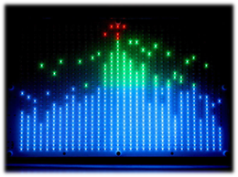


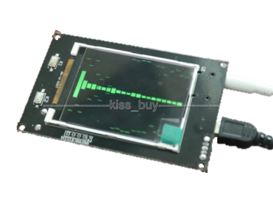
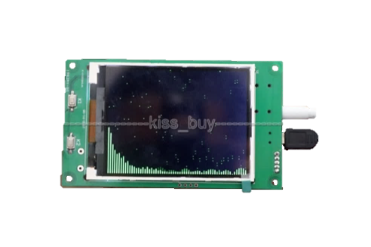
Which one would you most likely buy?
1 | 2 | 3 | 4 | 5
£61.75 | £45.99 | £8.01 | £14.99 | £18.89

Slide 24
Which one would you most likely buy?
Most people liked the first picture due to the amount of detail and the colours.
They liked it because they said it looks high quality as it is expensive which means that they assume that it is high quality

Slide 25
Survey Results
Open-Ended Questions

Slide 26
What do you like most about this product?
Many people liked the multiple colours
They also liked he size and the resolution of the larger products
They also thought that the products look attractive

Slide 27
What don't you like about this product?
They though the products were expensive but most did not know what an audio spectrum analyser is and the average price you would pay for one
So most people do not have much experience in the pricing of audio spectrum analysers

Slide 28
If I was to make one what would you want it to have?
Many people want me to make my unit multi coloured
They also want me to make it easy to use and have multiple inputs
They also want it to look nice and be large
They would like the casing to be made out of wood

Slide 29
What would you expect to have to pay for this product?
Average: £34.09
The people who answered my survey did not know mych about audio spectrum analysers
So their target price was lower than it would be and also my product will cost more as it is a prototype

Slide 30
Survey Conclusion
Most People Don’t Own A Spectrum Analyser
Most People are not sure how often they would use this product
The No. 1 Spectrum analyser was the RGB 32*32 Screen Audio LED Level Meter Display Spectrum Analyser DIY Amplifier priced at £61.75 – This was based on aesthetics only – The people surveyed were only given a picture and a price
The thing they likes the most was the multiple colours, followed by how attractive it was
The thing they disliked the most was that they were expensive and they disliked that they didn’t have remote controls
They wanted multiple colours the most, followed by it having multiple audio inputs, then a wooden casing
The average price they would pay for it was £34.09

Slide 31
What I will do based on the Results
Make It Relatively large
Make it Multi Coloured with colour customisation
Make it Look Good
Have a high resolution for more detail
Make it easy to use
Make it low-cost
Add a remote control
Make it user friendly
Make it’s case out of wood

Slide 32
Specifications
It will have a internal power supply as it will need to produce 30A for the LED panels at 5v.
It will use a standard IEC power connector with a hard power switch.
It will have a black painted wood case to make the display stand out
The wood will be painted black once the unit is assembled to hide the joints in the wood
There will be a clear acrylic sheet in the front of the case to protect the led boards and to stop people touching the led boards
Picture hook for the option to wall mount the unit
It will have mounting slots on the back for laser cut acrylic legs to make the unit more stable so it doesn’t fall over. The acrylic legs will have holes in them for a screw in the side of the case to slot into them so they are secure and they don’t fall out
It will have the power socket, audio ports and SD card slot recessed on back of unit in a recess that so when it is on a wall it lies flat. The recess will have the inputs at a 90° angle so the ports are facing sideways. The recess will be fairly large to allow for different connector sizes and cables
It will have a groove cut out of bottom lip on unit so cables can run down the wall it is mounted on
It will have a hard power switch on side of unit so power can be completely isolated from the unit to minimise fire risk
The audio inputs it will have
Microphone for use with audio sources which can be heard by the unit and do not want to use an Aux cable
Microphone should be mounted to the front of the unit for the best signal from the sound in the surrounding area
Microphone needs a preamp to bring it up to line level
3.5mm audio socket with another 3.5mm audio socket for pass-through and isolation so it doesn’t distort the audio going in if they are using a passive splitter
Audio must be actively converted to mono to prevent distortion on the audio input as it could be passively split somewhere or be using the pass-through socket
All audio inputs must be isolated from each other and when a input is selected it must pass through an auto volume control circuit before entering the microcontroller. So the audio can be scaled to get the most amount of detail out of it
It will have an IR remote control for control without touching the unit
A button on the remote should be used to change between the audio inputs and turn of the unit in turn in the pattern: Aux socket, Microphone, Off
A button on the remote should be used to change the display style for the spectrum analyser, modes could include variants of live mode showing the current audio frequencies, peak hold mode where dots show when the audio peak in the last few seconds and how high the peak was, and a mode when the whole screen is on and gets dimmer and gets brighter when a beat happens in the audio. The modes could include horizontal or vertical variants of these modes.
A button on the remote should be used to change the colour pattern of thee screen. Patterns would be stored on a SD card with a picture for each pattern so the user could create their own patterns
The unit must have an SD card slot for image files stored on an SD card. The file format used will be 24bit .bmp
Images will be stored in a folder called PATTERNS

Slide 33
Product Design

Slide 34
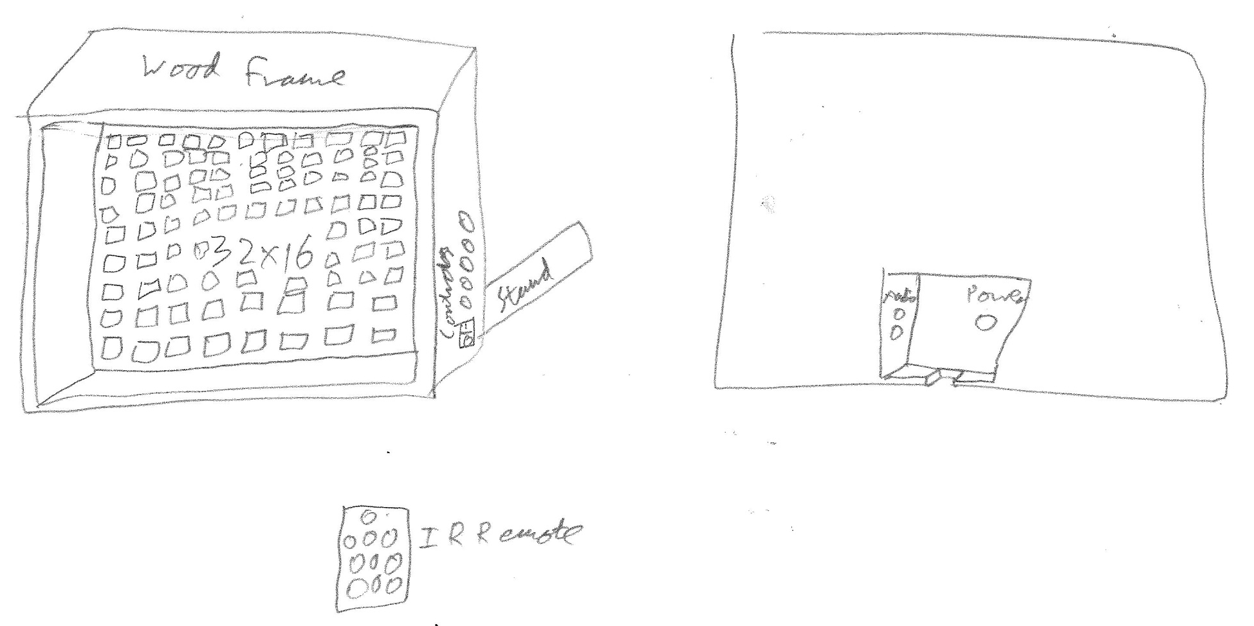
Original Design

Slide 35
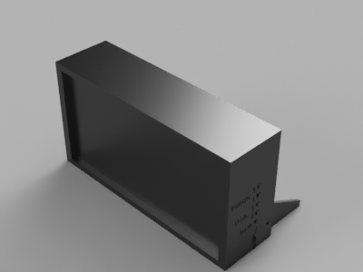
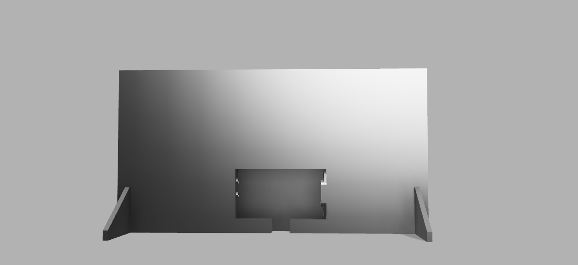
V1
LED Panels
Side Controls
Rear Stands
Audio Ports
AC Port

Slide 36
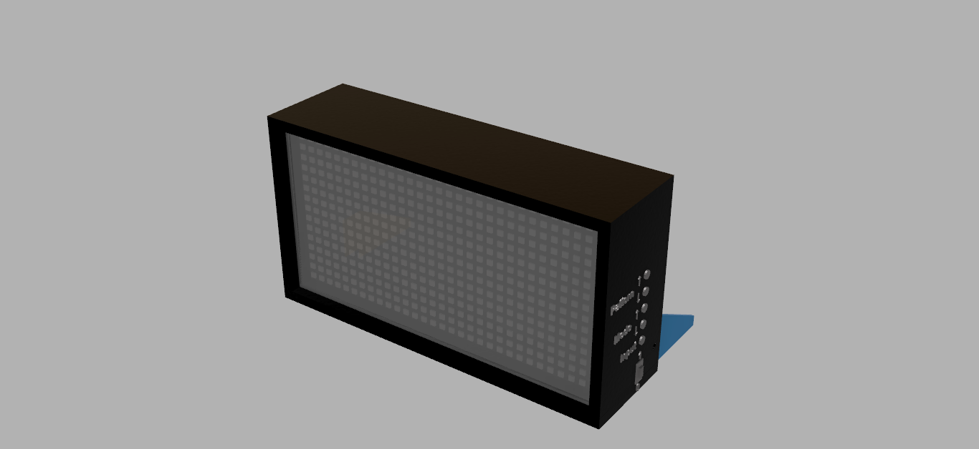
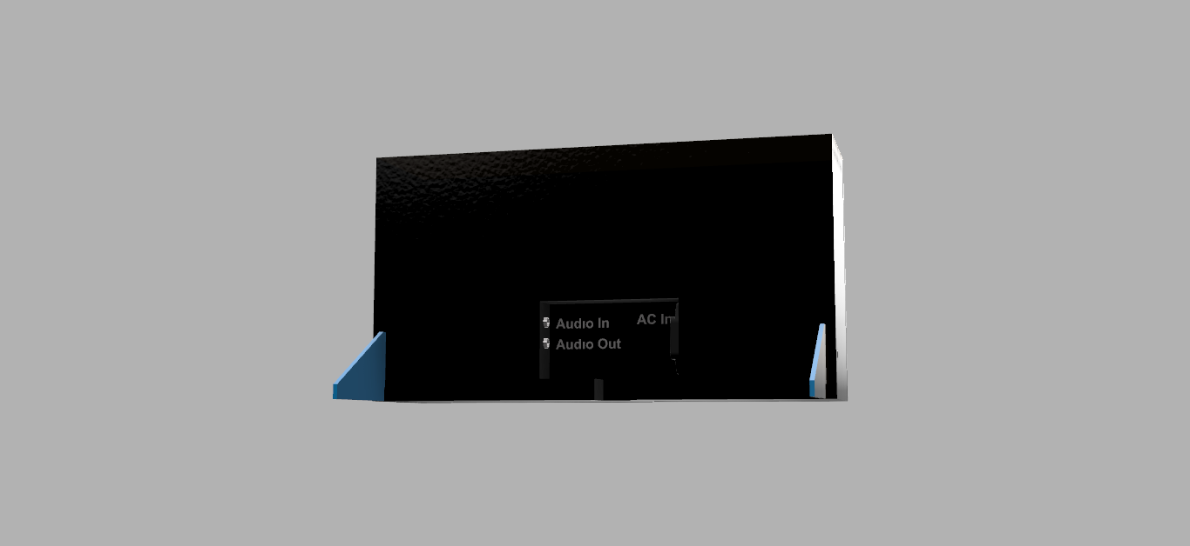
V4
Screen Cover
LED Panels Behind

Slide 37
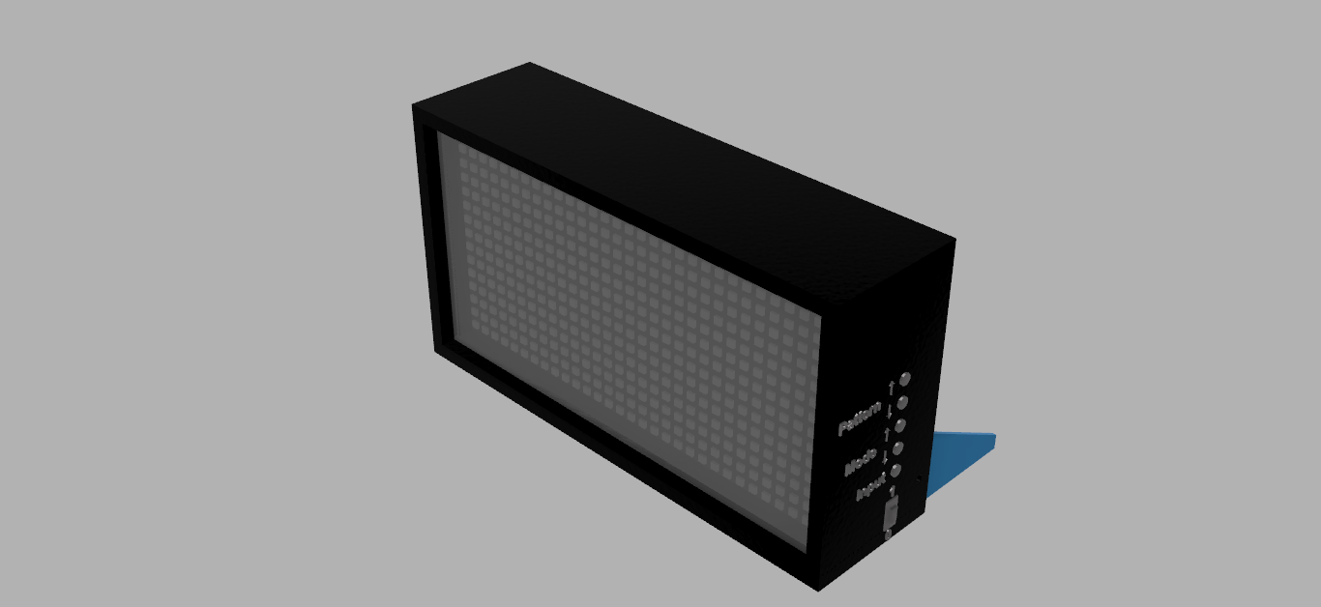
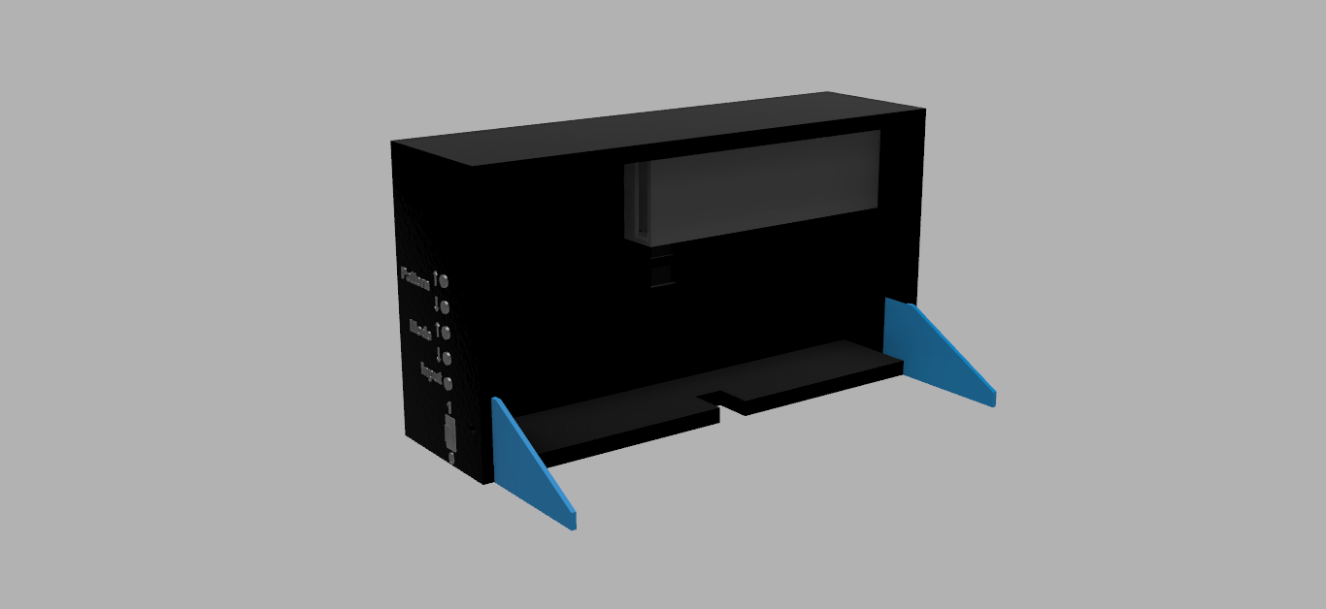
V7
Power Supply
Power Supply Holder

Slide 38
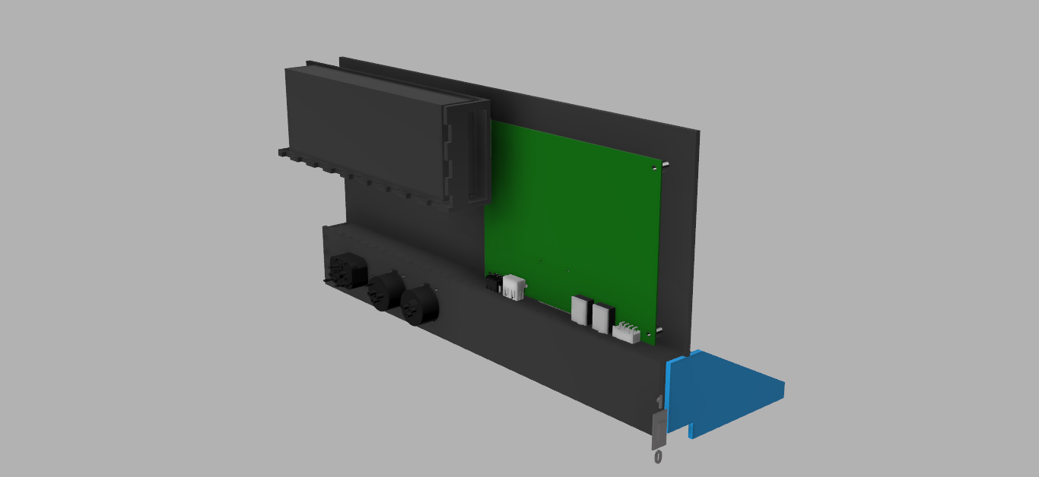
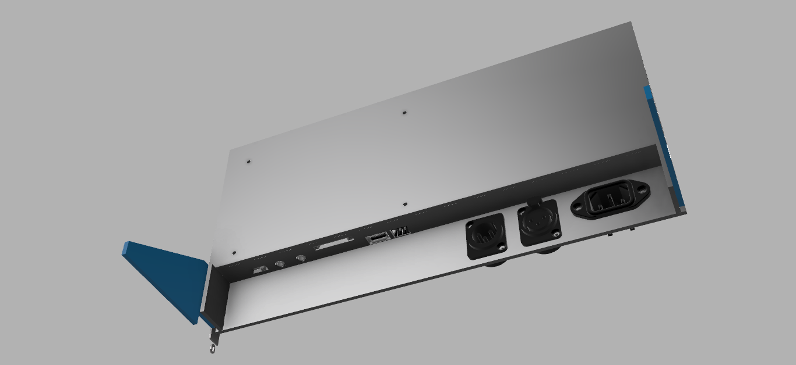
V20
Main PCB
DMX Ports
AC Port
Pattern Mode Switch
Audio Ports
SD Card Slot
USB Charging Port
Glediator Connector

Slide 39
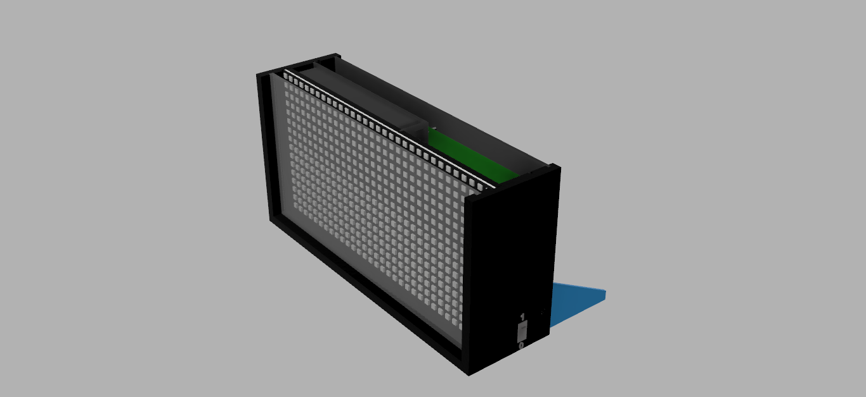
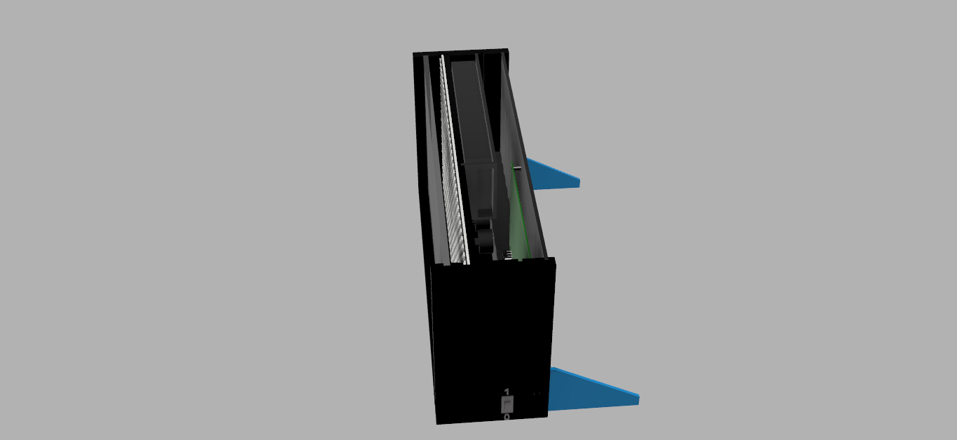
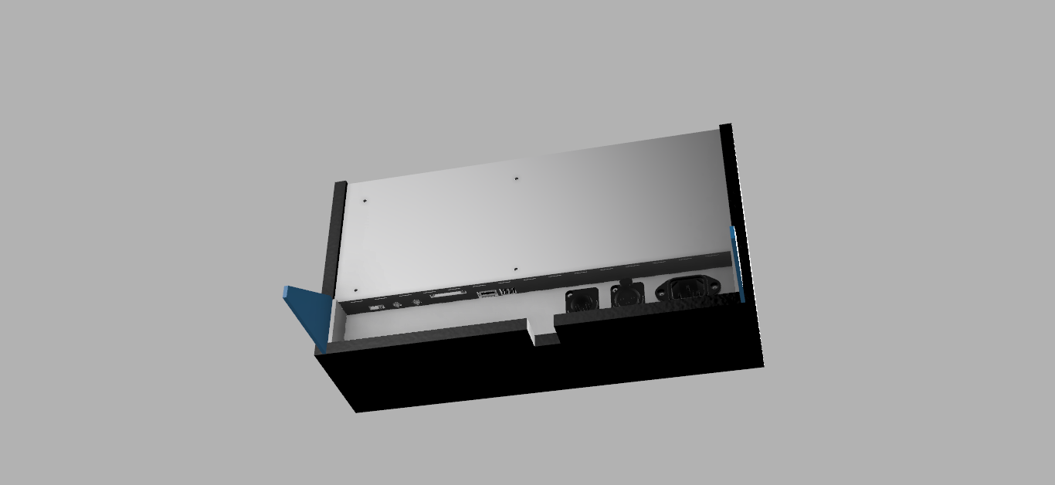
V21

Slide 40
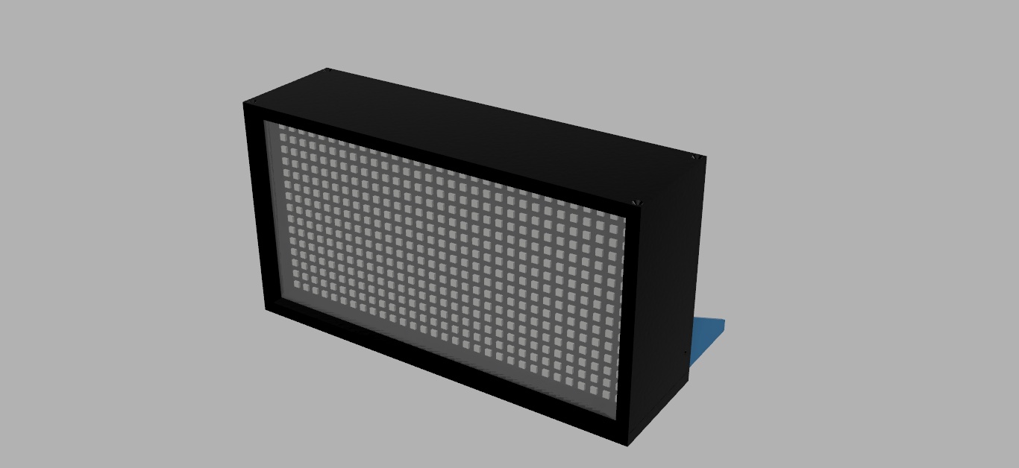
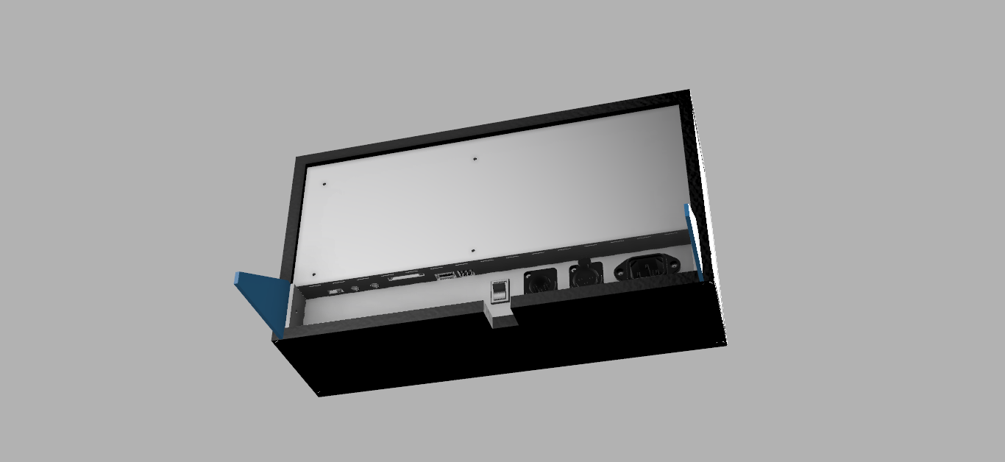
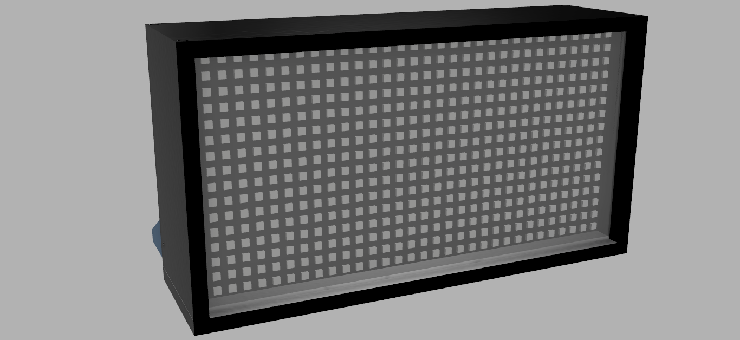
V37
Power Switch
Screw Holes
IR Receiver

Slide 41
V44

Slide 42
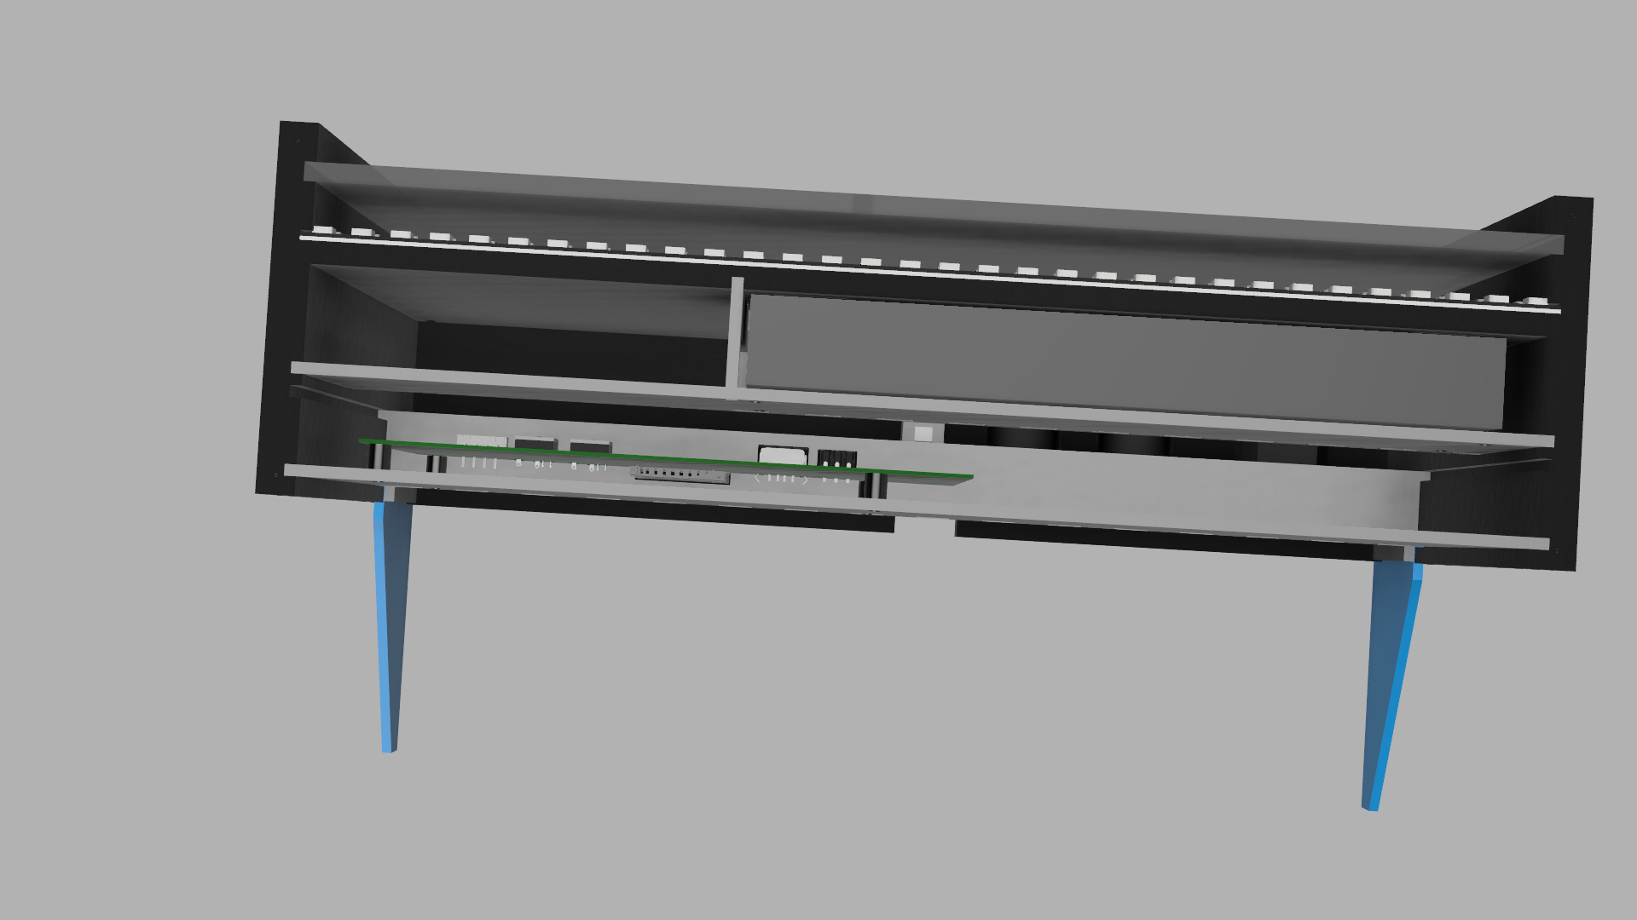
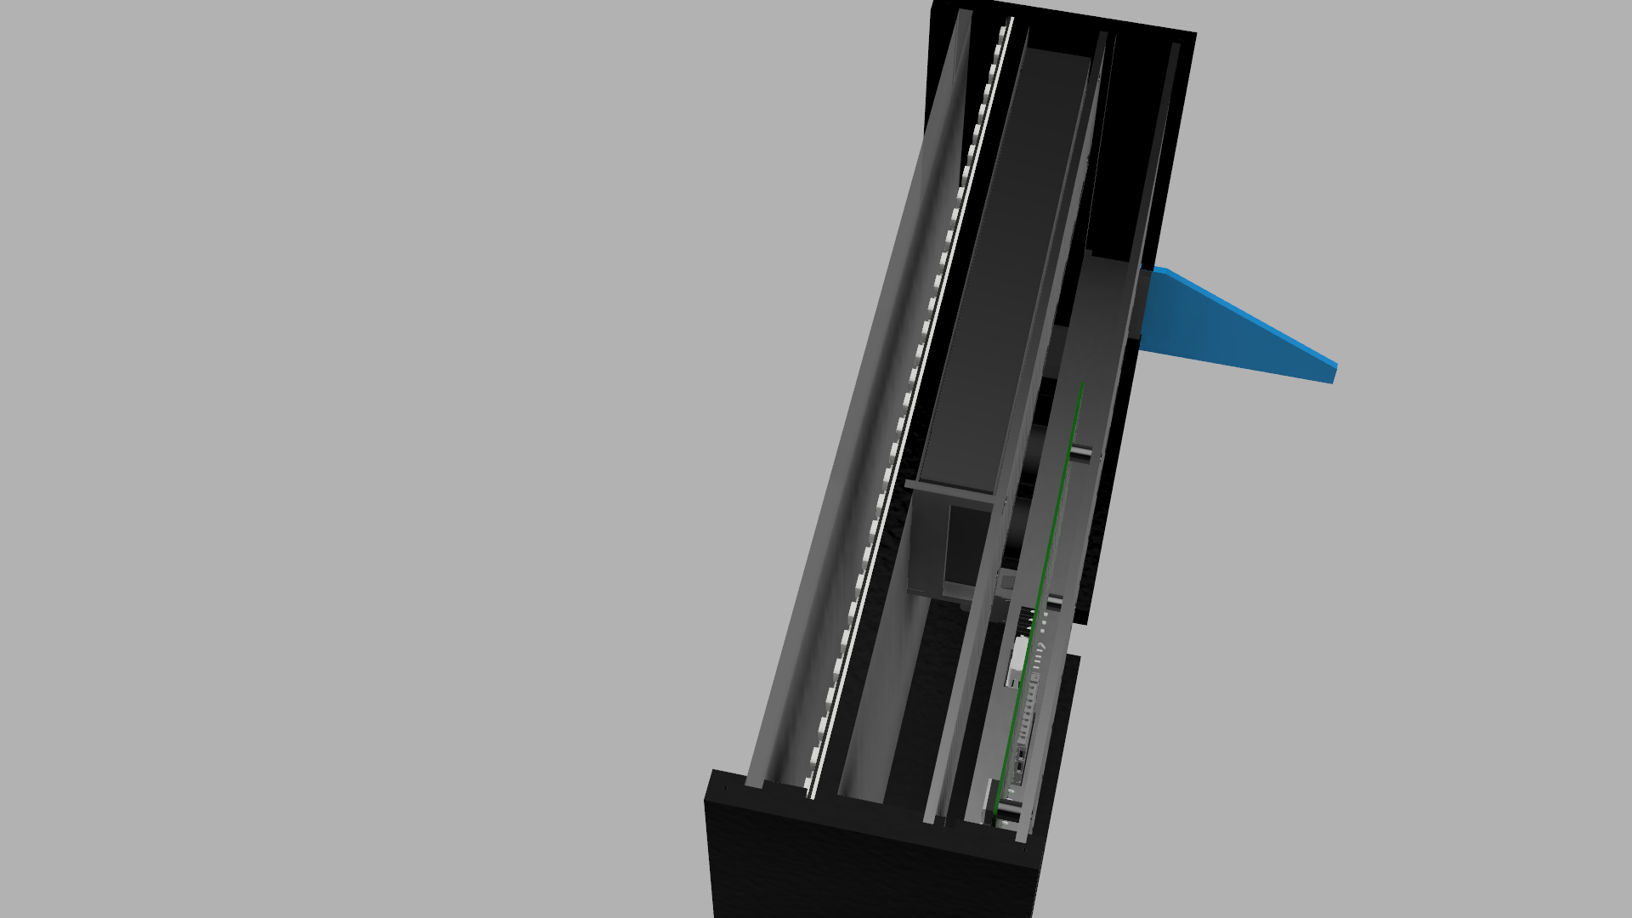
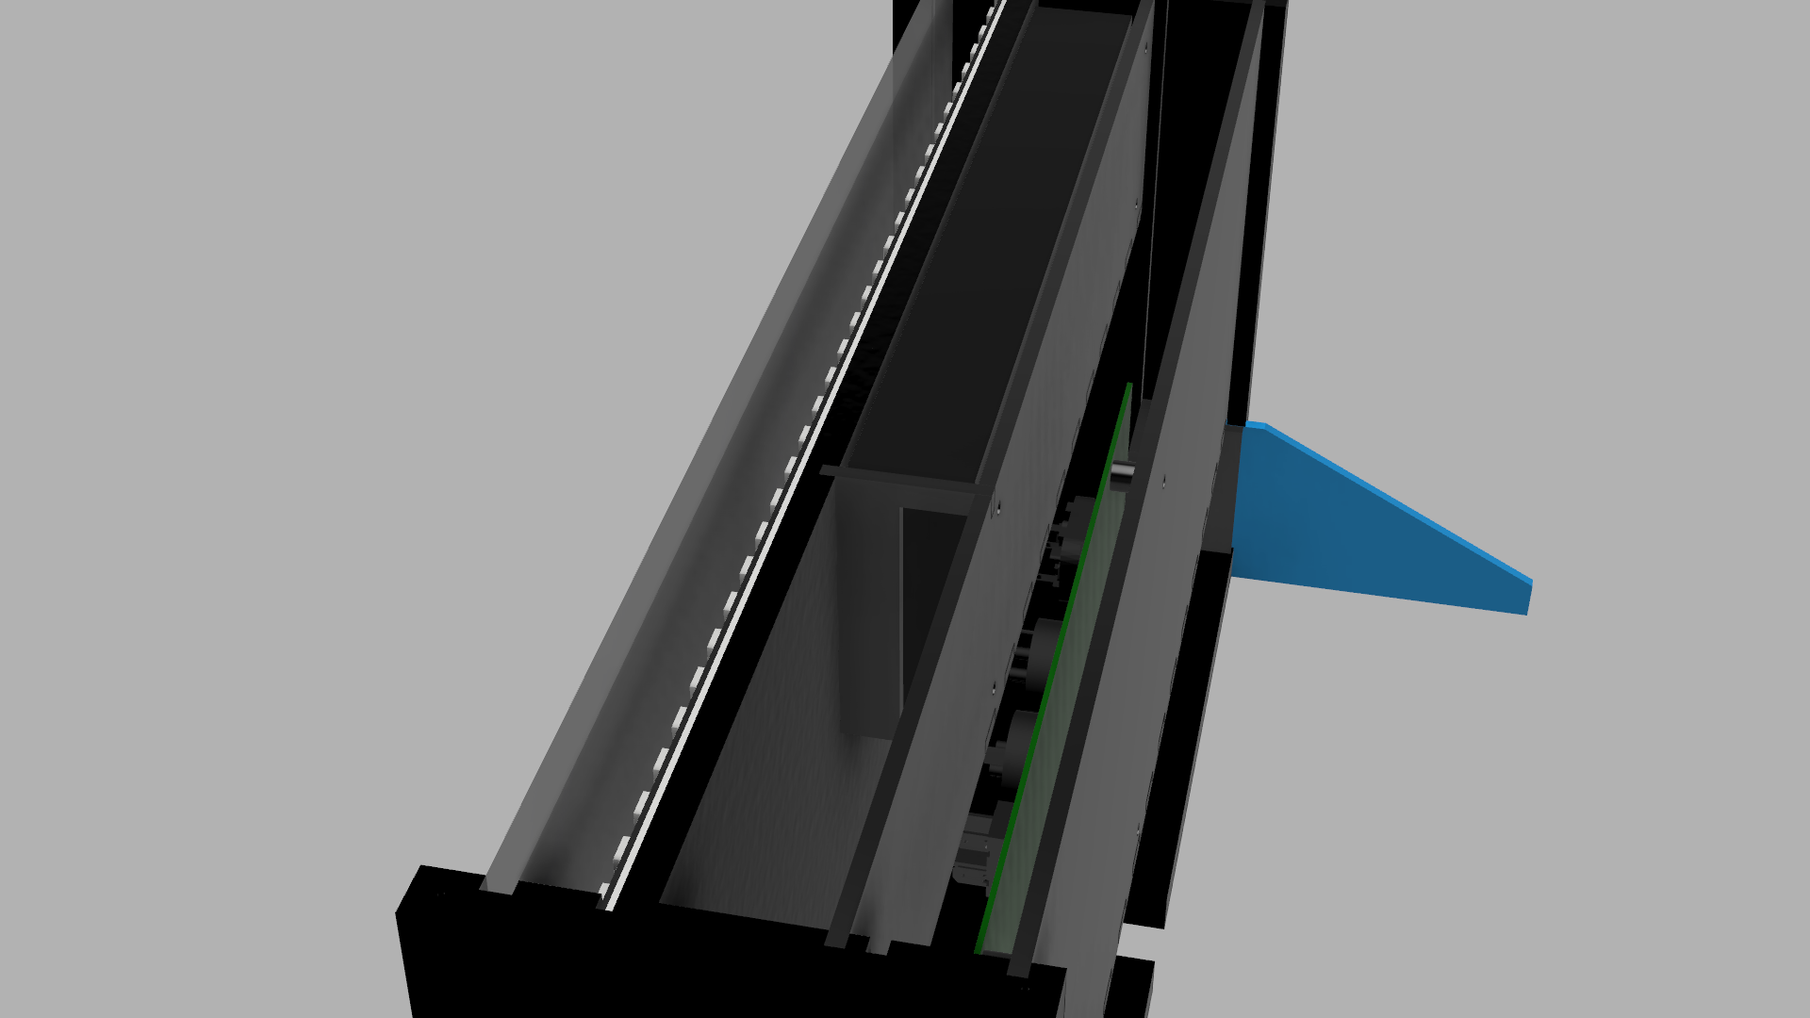
V44

Slide 43
Individual Casing Parts

Slide 44
10mm MDF

Slide 45
Top and Bottom Pieces (2x)
All measurements in mm

Slide 46
Left Side Piece (1x)
All measurements in mm

Slide 47
Right Side Piece (1x)
All measurements in mm

Slide 48
3MM WOOD

Slide 49
Rear Back Panel (1x)
All measurements in mm

Slide 50
Rear IO Panel (1x)
All measurements in mm

Slide 51
Rear PCB IO Panel (1x)
All measurements in mm

Slide 52
Rear Stand Covers (2x)
All measurements in mm

Slide 53
Back Power Supply Holder (1x)
All measurements in mm

Slide 54
Bottom Power Supply Holder (1x)
All measurements in mm

Slide 55
Side Power Supply Holder (1x)
All measurements in mm

Slide 56
LED Back Panel (Front) (1x)
All measurements in mm

Slide 57
LED Back Panel (Back) (1x)
All measurements in mm

Slide 58
3MM Acrylic Transparent Black

Slide 59
Screen Protector (1x)
All measurements in mm

Slide 60
Rear Stands (2x)
All measurements in mm

Slide 61
3d Printed Parts BLACK ABS

Slide 62
PCB Standoffs (4x)
All measurements in mm

Slide 63
Research

Slide 64
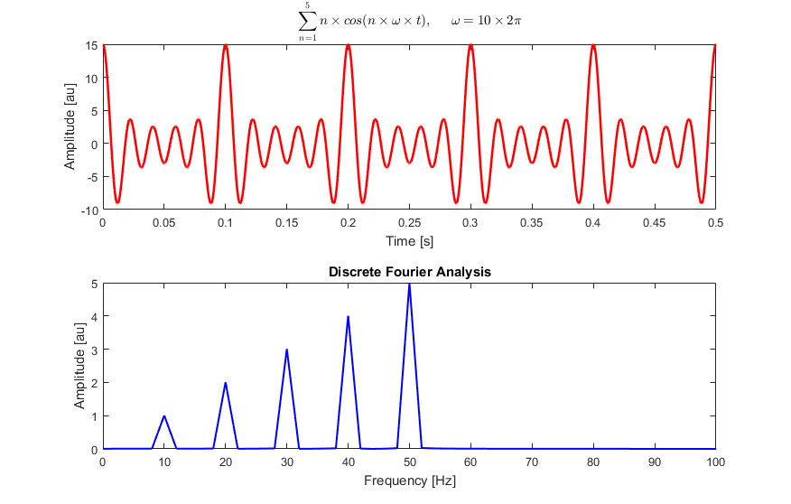
Measuring the audio spectrum.
After putting a bit of research into the technology of spectrum analysis, I found out that most use a technology called FFT (Fast Fourier Transform).

Slide 65
Measuring the audio spectrum.
Others use a technology called Fast Hartley Transform (FHT), I plan to use this as it uses less memory and is faster than FFT.

Slide 66
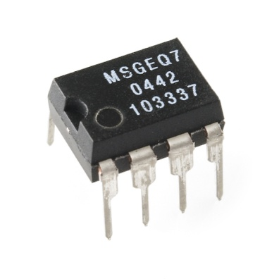
Measuring the audio spectrum
Others might use a chip such as the MSGEQ7 which separates the audio signal into 7 different frequency bands with very little other components needed

Slide 67
Systems Analysis

Slide 68
Inputs
Product | Buttons | IR Remote | DMX | Glediator | Switch
Use in product | To perform the same basic functionality as the IR Remote but more basically | To be the main input for the unit to control and setup the unit. To switch between display modes and patterns and setup information such as DMX address | A standard protocol using XLR connectors which transfers data using RS485 which is common in the lighting industry. It will be used to perform the functionality of the IR remote, remotely | A protocol use for controlling large LED matrices with a computer over serial. This will be used for the LED panels to be used as a screen to display stuff | To switch between DMX, Glediator and IR Remote modes
Advantages | Simple Easy to understand Low-cost | Simple Wireless Cheap Allows unit to be hard to get to but easy to control | Industry standard Compatible with large lighting systems | Helpful Allow control of the unit for each pixel individually Easy to implement Cheap | Easy to understand Hard switch keeps state between reboots No remote needed
Disadvantages | Requires space Large Very basic | Needs batteries Easy to lose | Large connectors | Easy to damage | Hard to access as it would be on the back of the unit
Will I use it | No because there will need to be a lot of buttons to manage the device | Yes it will be the main input device for the unit as it will be used for all configuration of the unit and selecting modes | Yes it will be used to preform the basic functionality of the remote for use with lighting systems | Yes as it allows the LED panels to be controlled by an external computer so the user will able to display whatever they want | Yes as you usually would just set the mode and leave the device in that mode

Slide 69
Audio Inputs
Product | Auxiliary port | Microphone | Internal MP3 Player
Use in product | To input audio from a standard 3.5mm stereo audio connector | To allow the unit to be used by picking up ambient sound and not requiring audio cables | To allow music to be played from removable media e.g. SD card/USB drive
Advantages | Simple Commonly Used Standard Most people have one Cheap | Simple Cheap Allows the unit to be used without any external cables – just a power cord | Allows unit to play music without any external devices
Disadvantages | Requires an audio cable to be plugged into the unit | Picks up ambient noise Low quality Muffled as it will be inside the unit | The would have to be no screen and wherever it is mounted it would look out of place Hard to use No one really used them any more they just use their phones An external amplifier would be needed
Will I use it | Yes because it would offer higher quality than the Microphone, it would also have a pass-through socket to allow it to pass the audio in to an amplifier | Yes because it will make the unit be able to function without needing any audio cables so it can be place far away from the amplifier and if it still had sound it would be able to function | No because you would need an external amplifier anyway so it would be pointless as you could connect any device to the AUX port instead and no one uses them anymore

Slide 70
Processing
Product | PIC | ATMEGA | MSGEQ7
Use in product | To be an alternate main controller of the unit | To be the main controller of the unit and deal with controlling the LED panels and convert the audio to the separate bands via FFT | To convert the audio into frequency bands
Advantages | Simple Easy to understand Low-cost | It has a large amount to SRAM which is required to control the LEDS and perform the FFT Large amount of libraries available Programmed using C (I have experience in using the language) | Simple No programming needed
Disadvantages | Requires programming Programmed using basic which is very low level Not that many libraries available Low amount of SRAM Not as fast as the ATMEGA | Expensive Requires programming | Only 7 frequency bands Cannot directly control the addressable LED panels
Will I use it | No as I will have to write all of the code from scratch for controlling the LEDs and I do not have experience of programming in PIC BASIC and programming it using a flowchart is too basic for performing complicated functions like I am and also they do not have a large a | Yes as the device can perform the FFT needed to convert the audio into digital frequency bands and then directly control the LED panels and it will also be able to load patterns of an SD card and load them onto the panel. Also it will require less programming as people have made libraries for uses such as FFT and controlling addressable LEDS | No as it would require an external controller to convert the Frequency bands into digital signals and it only have 7 bands which is quite small and it is very basic

Slide 71
Outputs
Product | Status LED | Addressable LED Panels | Buzzer | Speaker | 7 Segment Displays
Use in product | To show basic information such as power and a another LED to show if it is getting and IR signal | To be the main output of the unit to display the audio spectrum like a bar graph with different display modes. It has RGB Leds that are individually controllable | To make a sound to indicate statuses such as a missing SD card or receiving a signal from a IR remote | To play the audio that the unit is receiving so no external speakers are needed | To show the mode the unit is in or other information
Advantages | Simple Easy to understand Low-cost Easy to read quickly no confusing codes | Big Bold Large amount of customisation Requires only 1 output on microcontroller | Simple Can be inside the unit – no external cut-outs needed Easy to notice – you do not need to look at the unit | Helpful External speakers are not needed with the unit | Easy to read Can be used with external
Disadvantages | Can draw unwanted attention Can | Expensive Large Power consumption (up to 15A @ 5v per panel) | Annoying Can be unwanted Hard to make it give meaningful information | Needs amplification Hard to produce proper stereo sound Will most likely have very little bass | Large They look ugly as they are very basic
Will I use it | Yes it will be in the power switch to show the unit has power | Yes the will be the main output device for the unit as the can display various patterns and colours | Yes it will be inside the unit on the PCB and will be used to indicate when it receives an IR signal | No as the people who would use this unit would most likely have a speaker system better than some small, terrible speakers | No as they would use up valuable space on the front of the unit whereas the LED panels could also be used to display the mode

Slide 72
Storage for patterns
Medium | USB memory | SD Card | Internal Microcontroller Storage
Use in product | To store patterns for device | To store patterns in device | To store basic patterns and modes
Advantages | Widely Available and supported Small connector Easy for use to adjust patterns | Widely Available and supported and easy to interface with microcontroller Small connector Easy for use to adjust patterns | Super easy to implement No external device interfacing needed
Disadvantages | Hard to interface with microcontroller Hard to find compatible devices | Some issues with compatibility to | Uses valuable program space Not user customisable
Will I use it | No because it is hard to interface USB memory with a microcontroller | Yes because it is easy to interface and is easily user adjustable | Yes to store a basic pattern and different modes for when the SD card is not available

Slide 73
Possible Circuits

Slide 74
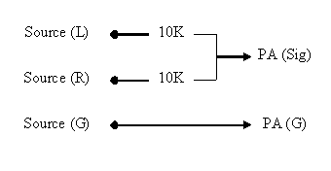
Audio Mixer for mixing the Left and right audio channels
Connect the two audio signals together using a 10k resistor on each of the signals
This circuit construction provides 10 kohm input impedance and around 5 kohm output impedance.
Both of the values are well within what you would expect from an audio equipment.

Slide 75
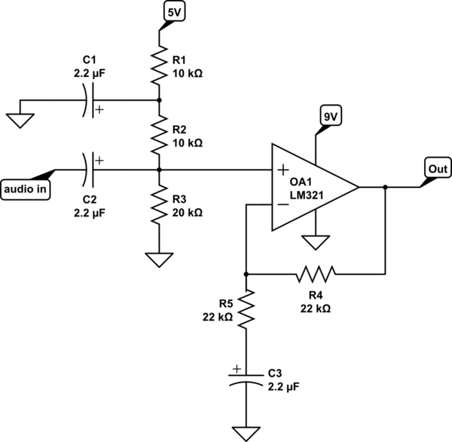
Audio amplifier and leveller
This circuit can be used with the LM324 which is a quad version of the LM321
This can be used for the AUX input of the device

Slide 76
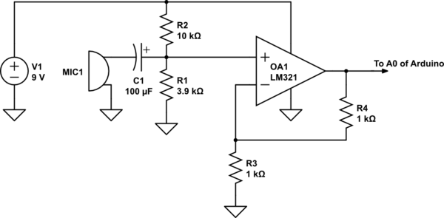
Audio amplifier and leveller
This circuit can be used with the LM324 which is a quad version of the LM321
This circuit can be used for the microphone input of the unit

Slide 77
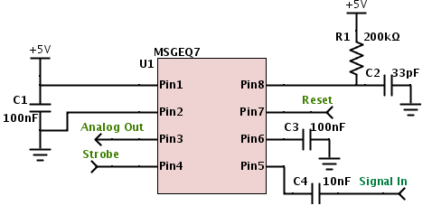
MSGEQ7 - 7 Band filter IC

Slide 78
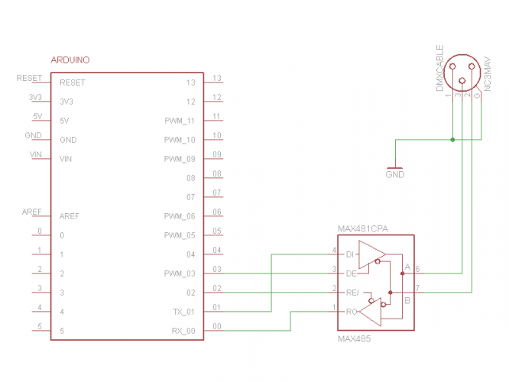
DMX interface

Slide 79
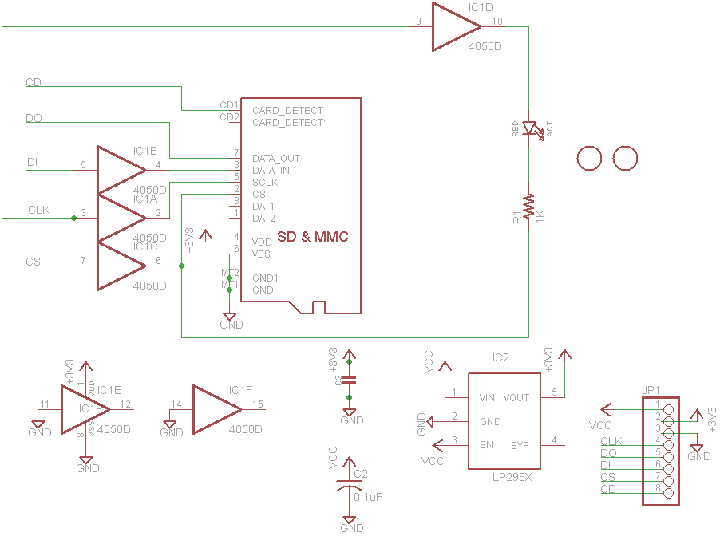
SD Card interface

Slide 80
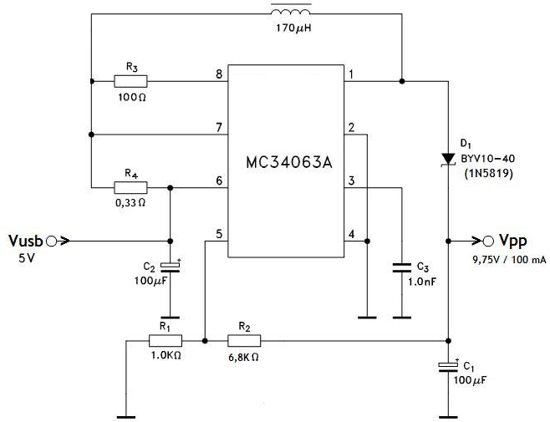
5V to 9V Boost Converter
This is to boost the 5v power supply up to 9v for the audio amplifiers

Slide 81
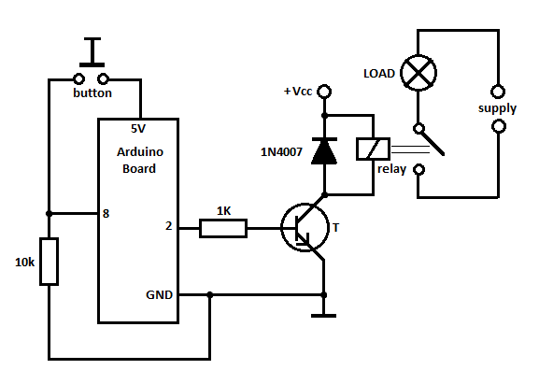
Audio Input Switching Circuit

Slide 82
Possible components

Slide 83
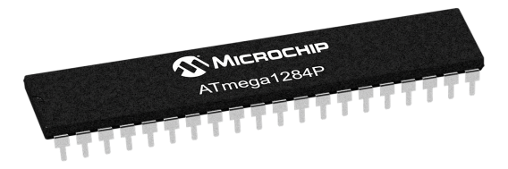
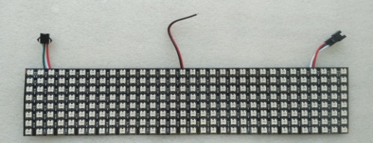
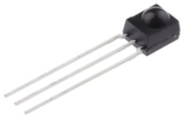
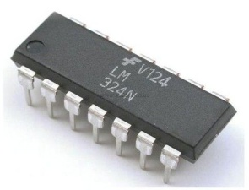
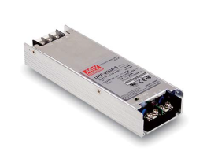
Possible Components
Picture | Component | Use
 | ATMEGA 1284p | To be the main microcontroller of the product and control the LED panels, perform the frequency analyses and interface with the SD card
 | 32x8 WS2812B Led Panel | To be the display of the product to show the different frequency bars and allow customisation of the RGB colour
 | IR Receiver | To receive the signal from the IR remote which will be how the user controls the device
 | LM324 | To convert the audio inputs for the unit into a logic level that the microcontroller can use also it only needs an single power supply so it is easy to use
 | Mean well UHP-200A-5 | To power the unit as the LED panels require 15A maximum each so it can supply 40A at 5v as it is a 200W power supply which leaves 10A spare for other circuitry and the USB port

Slide 84
Social, Moral and Environmental Issues

Slide 85
Social and Moral Issues
The product will have bright lights which could disturb other people
The product would usually be used with some speakers so they could disturb other people
The product will be designed so that it can be repaired if it breaks
The product could be dangerous to people with photosensitive epilepsy due to the flashing lights on the display

Slide 86
Environmental Issues
Most of the case will be made out of soft wood and plywood
The wood can be sourced from sustainable sources which are FSC approved
FSC means that the wood is sourced from sustainable locations where the trees are replanted and managed to prevent deforestation
Some parts of the case will be made of plastic which can cause issues due to recycling as they could not be widely recycled
The circuit does not contain any batteries which is good because they could damage the environment by being incorrectly disposed
The screws will be metal which is widely recyclable
The solder used will not be lead-based so it will not poison the environment when it is disposed
The copper on the PCB will be able to be reclaimed as it is worth quite a lot which helps the environment as it is a lot easier and requires a lot less energy than making new copper from copper ore which releases a lot more pollution

Slide 87
Program Research

Slide 88
FHT
I found a library with example code for FHT which ran on the Arduino Bootloader
http://wiki.openmusiclabs.com/wiki/ArduinoFHT
It included example code for basic FHT which I incorporated into my master code

Slide 89
FastLED
I found a library called FastLED which was a library that ran on the Arduino Bootloader which allowed the microcontroller to easily control LED panels like the WS2812B panels I have
http://fastled.io/
I used some example code to help me write the code to control the LED panels

Slide 90
Reading Image files from an SD card
After a lot of research I determined it was too hard to read standard image files from and SD card. I created a program in python to allow images to be stored in a database on the SD card in an easy way for it to be easy to decode the images on the microcontroller

Slide 91
Reading files from an SD card
To read files from an SD card the SDFat library allows standard fat – formatted SD cards to be accessed on the Arduino Bootloader
I used some example code to be able to decode the images from the SD card

Slide 92
Circuit Prototyping

Slide 93
Controlling the LED panels
The led panels I bought have the LEDS arranged in a vertical snake
I created some code to convert an XY coordinate into the ID of the pixel
Diagram
┌ | ┐ | ┌ | ┐ | ┌ | ┐ | ┌ | ┐ | ┌ | ┐ | ┌ | ┐ | ┌ | ┐ | ┌ | ┐ | ┌ | ┐ | ┌ | ┐ | ┌ | ┐ | ┌ | ┐ | ┌ | ┐ | ┌ | ┐ | ┌ | ┐ | ┌ | ┐
│ | │ | │ | │ | │ | │ | │ | │ | │ | │ | │ | │ | │ | │ | │ | │ | │ | │ | │ | │ | │ | │ | │ | │ | │ | │ | │ | │ | │ | │ | │ | │
│ | │ | │ | │ | │ | │ | │ | │ | │ | │ | │ | │ | │ | │ | │ | │ | │ | │ | │ | │ | │ | │ | │ | │ | │ | │ | │ | │ | │ | │ | │ | │
│ | │ | │ | │ | │ | │ | │ | │ | │ | │ | │ | │ | │ | │ | │ | │ | │ | │ | │ | │ | │ | │ | │ | │ | │ | │ | │ | │ | │ | │ | │ | │
│ | │ | │ | │ | │ | │ | │ | │ | │ | │ | │ | │ | │ | │ | │ | │ | │ | │ | │ | │ | │ | │ | │ | │ | │ | │ | │ | │ | │ | │ | │ | │
│ | │ | │ | │ | │ | │ | │ | │ | │ | │ | │ | │ | │ | │ | │ | │ | │ | │ | │ | │ | │ | │ | │ | │ | │ | │ | │ | │ | │ | │ | │ | │
│ | │ | │ | │ | │ | │ | │ | │ | │ | │ | │ | │ | │ | │ | │ | │ | │ | │ | │ | │ | │ | │ | │ | │ | │ | │ | │ | │ | │ | │ | │ | │
┘ | └ | ┘ | └ | ┘ | └ | ┘ | └ | ┘ | └ | ┘ | └ | ┘ | └ | ┘ | └ | ┘ | └ | ┘ | └ | ┘ | └ | ┘ | └ | ┘ | └ | ┘ | └ | ┘ | └ | ┘ | └

Slide 94
Controlling the LED panels: Code
int PosToIndex(int POS_x, int POS_y){
int PIndex = 0;
bool isupperpanel = POS_y > 7;
if (POS_x % 2 == 0){
if (isupperpanel) {
PIndex = 23 - POS_y;
}
else {
PIndex = 7 - POS_y;
}
}
else {
PIndex = POS_y;
}
PIndex += 8*(31-POS_x);
if (isupperpanel) {
PIndex += 248;
}
return PIndex;
}

Slide 95
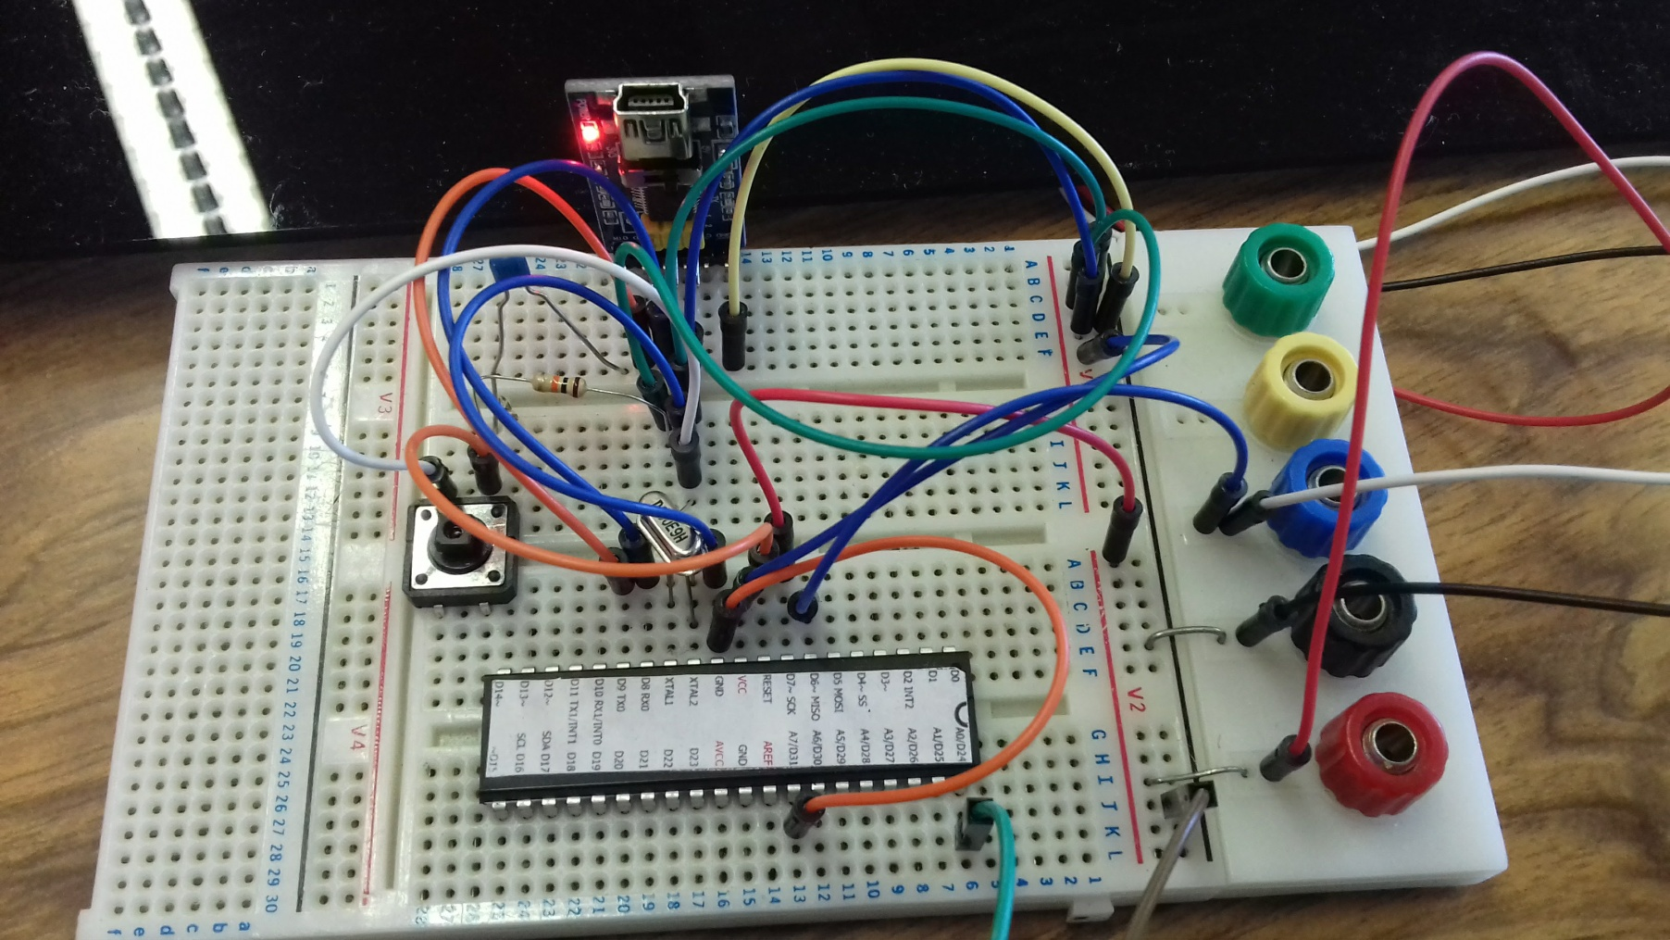
Basic Circuit
Microcontroller
Programmer
External Clock Crystal
Reset Button

Slide 96

Initial Light Test
I determined that the LEDs were too bright just on their own

Slide 97

Initial Light Test
I added a piece of darkened acrylic and made a small program to test each LED sequentially

Slide 98
Initial Light Test: Code for Setting Each LED
void setLED(int LED_x, int LED_y, float LED_r, float LED_g, float LED_b){
leds[PosToIndex(LED_x,LED_y)].setRGB( float(LED_r) * (brightness_scale/100), float(LED_g) * (brightness_scale/100), float(LED_b) * (brightness_scale/100));
}

Slide 99

Initial Light Test
I added a piece of darkened acrylic and made a small program to test each LED sequentially

Slide 100
Initial Light Test: Code for looping through LEDs
void loop() {
// put your main code here, to run repeatedly:
for (int yi = 0; yi < 16; yi++ ){
for (int xi = 0; xi < 32; xi++ ){
setLED(xi,yi,255,0,0);
FastLED.show();
delay(step_delay);
}
}
for (int yi = 0; yi < 16; yi++ ){
for (int xi = 0; xi < 32; xi++ ){
setLED(xi,yi,0,255,0);
FastLED.show();
delay(step_delay);
}
}
for (int yi = 0; yi < 16; yi++ ){
for (int xi = 0; xi < 32; xi++ ){
setLED(xi,yi,0,0,255);
FastLED.show();
delay(step_delay);
}
}
Continued.
for (int yi = 0; yi < 16; yi++ ){
for (int xi = 0; xi < 32; xi++ ){
setLED(xi,yi,255,255,255);
FastLED.show();
delay(step_delay);
}
}
for (int yi = 0; yi < 16; yi++ ){
for (int xi = 0; xi < 32; xi++ ){
setLED(xi,yi,0,0,0);
}
}
FastLED.show();
}

Slide 101

FHT Test
I joined the FHT example code to my basic LED test sketch with a bit of extra code to form bars from the FHT output of an audio signal

Slide 102
FHT Test: Code for changing LED to target image
void boolLED(int LED_x, int LED_y, bool LED_State){
//Serial.println("BoolLED");
int PIX_Index = PosToIndex(LED_x,LED_y);
if (LED_State) {
leds[PIX_Index].r = image[PIX_Index*3];
leds[PIX_Index].g = image[PIX_Index*3+1];
leds[PIX_Index].b = image[PIX_Index*3+2];
}
else {
leds[PIX_Index].r = 0;
leds[PIX_Index].g = 0;
leds[PIX_Index].b = 0;
}
}

Slide 103
FHT Test: Code for drawing a bar
void drawBar(int X_Bar, int Bar_Val) {
//Serial.println("DrawBAR");
Bar_Val = constrain(Bar_Val, 0, 16);
for (byte ycoord = 0; ycoord < 16; ycoord++){
boolLED(X_Bar,ycoord,ycoord < Bar_Val);
}
}

Slide 104
FHT Test: Code for calculating FHT
void loop() {
while(1) { // reduces jitter
cli(); // UDRE interrupt slows this way down on arduino1.0
float aver = 0;
for (int i = 0 ; i < FHT_N ; i ++) { // save 256 samples
while(!(ADCSRA & 0x10)); // wait for adc to be ready
ADCSRA = 0xf5; // restart adc
byte m = ADCL; // fetch adc data
byte j = ADCH;
int k = (j << 8) | m; // form into an int
averlist[i] = k;
k -= 0x0200; // form into a signed int
k <<= 6; // form into a 16b signed int
fht_input[i] = k; // put real data into even bins
}
for (int i = 0 ; i < FHT_N ; i ++) {
int k = averlist[i];
k = constrain(k * 1.2, 0, 255);
aver = max(constrain(map(k, 0, 1023, 0, 255),0,255),aver);
}
//Serial.println("FHTrecorded");
aver = min(aver,255);
avlist[avlistplace] = aver;
avlistplace++;
if (avlistplace > AV_LIST_SIZE - 1) {
avlistplace = 0;
}
fht_window(); // window the data for better frequency response
fht_reorder(); // reorder the data before doing the fht
fht_run(); // process the data in the fht
fht_mag_log(); // take the output of the fht
Continued.
sei();
byte outputvars[FHT_N/4];
//Serial.println("FHTfinished");
float gaver = 0;
for (byte j = 0; j < AV_LIST_SIZE; j++) {
gaver += avlist[j];
}
gaver = gaver / (AV_LIST_SIZE / 4);
gaver = gaver / FHT_N;
float z = fht_log_out[1] * gaver;
z = min(z,255);
outputvars[0] = map(z, 0, 255, 0, 16);
for (byte i = 2; i < FHT_N/2; i+=2) {
float y = fht_log_out[i] + fht_log_out[i+1];
float z = y * gaver;
//float z = y;
z = min(z,255);
outputvars[i/2] = map(z, 0, 255, 0, 16);
}
for (byte xcoord = 0; xcoord < 32; xcoord++) {
drawBar(xcoord, outputvars[xcoord]);
}
FastLED.show();
}
}

Slide 105

Using an SD card to change the default target image
I connect the SD card to the microcontroller using the recommended connections on the SDFat website

Slide 106

Using an SD card to change the default target image
I used a test image on the SD Card to check that it was reading the image correctly

Slide 107
Using an SD card to change the default target image: Code to decode the image files: Other functions
void readChar(int expected_char) {
if (myFile.available()) {
current_im_char = myFile.read();
if (current_im_char != expected_char){
im_invalid = true;
}
} else {
im_invalid = true;
}
}
void readByte(){
if (myFile.available()) {
current_im_char = myFile.read();
} else {
im_invalid = true;
}
}

Slide 108
Using an SD card to change the default target image: Code to decode the image files
Continued.
int im_c_index = PosToIndex(im_X,15-im_Y);
readByte();
image[im_c_index*3] = current_im_char;
readChar(58);
readByte();
image[im_c_index*3+1] = current_im_char;
readChar(58);
readByte();
image[im_c_index*3+2] = current_im_char;
if (im_X < 31) {
readChar(59);
}
}
if (im_Y < 15) {
readChar(33);
}
}
readChar(38);
if (im_invalid) {
Serial.println("Invalid");
current_pattern = 0;
for (int i = 0; i < NUM_LEDS; i++){
image[i*3] = default_red;
image[i*3+1] = default_green;
image[i*3+2] = default_blue;
}
Serial.println(IMFileName);
}
myFile.close();
Serial.println("Finished");
}
}
}
void loadImage(int ID) {
if (ID == 0) {
for (int i = 0; i < NUM_LEDS; i++){
image[i*3] = default_red;
image[i*3+1] = default_green;
image[i*3+2] = default_blue;
}
} else {
String IMFileNameString = String(".imxs/imx-") + ID + String(".imx");
int IMFileNameString_len = IMFileNameString.length() + 1;
char IMFileName[IMFileNameString_len];
IMFileNameString.toCharArray(IMFileName, IMFileNameString_len);
if (SD.exists(IMFileName)) {
//Serial.println(IMFileName);
myFile = SD.open(IMFileName);
// read from the file until there's nothing else in it:
current_im_char;
im_eof = false;
im_invalid = false;
readChar(64);
readChar(16);
readChar(36);
readChar(32);
readChar(35);
for (byte im_Y = 0; im_Y < 16 && myFile.available() && !im_eof && !im_invalid; im_Y++) {
for (byte im_X = 0; im_X < 32 && myFile.available() && !im_eof && !im_invalid; im_X++) {

